Slide 1

PANTHER
WEBINAR
Friday 21st August 11:00am
Notes:
S

Slide 2
RECRUITMENT
14 Sites Open
17 Patients Recruited
We would like to welcome the following new sites Glasgow, Royal Free, Royal Liverpool, RUH Bath, UCLH, Wythenshawe and Edinburgh.
Congratulations to St Thomas’, Ealing, Royal Oldham and UCLH on your first recruits
1

Slide 3

RANDOX
Courier Sites
Step by step process:
When a patient has been selected as eligible – enter them on OpenClinica for the Patient ID
Contact the courier using the courier link (always do this first, do not worry if a sample is not collected/patient/family refuse, as the courier can always be cancelled). It is important to ensure the courier is on their way asap as this can save time
When ordering the courier, make sure you give exact details for collection/location, this makes the process easy for the courier to find you.
Once the sample is collected, and centrifuged, complete the details on the NEXUS portal (this process covers ordering the subphenotyping test) the portal is a separate link to the courier link
Reminder: please ensure no patient names/data are entered onto Nexus - use ID’s only.
All account codes begin with ‘PANT’
2

Slide 4
CONTRACTS
  An agreement with Randox has been signed.
  As the new Clinical Trial Regulations are in effect, a new mNCA template has been sent to all sites for review
3

Slide 5
TRAINING LOGS
  If your NMC/GMC number is entered correctly on a training form, there is no longer the need to forward the email you receive upon completion of training.
  Please note that the email you receive upon completion of training will act as your training log and should be kept safe for filing in the eISF.
4

Slide 6
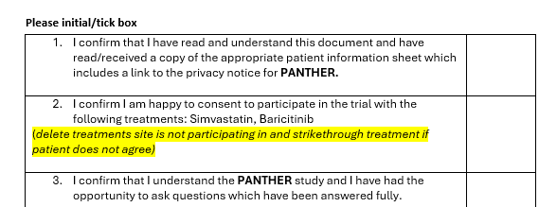
Screening Queries
  Please note that if patients meets the platform inclusion criteria but decline consent to one treatment, they can still be randomized to the other two.
You can input this information on our database and it will exclude them from that treatment. Ensure the consent form is completed correctly too.
5

Slide 7
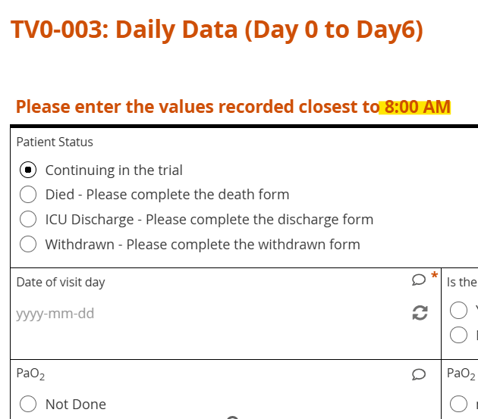
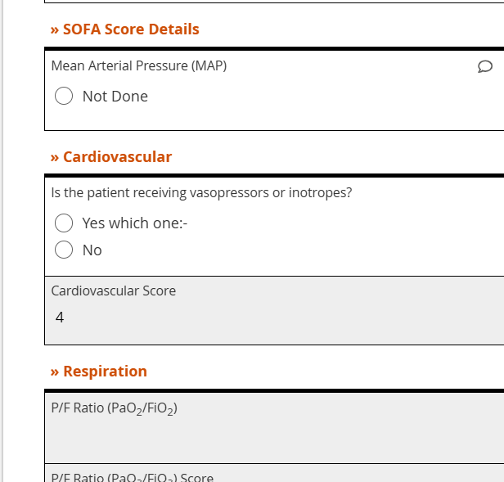
Database Queries
  When calculating the P/F Ratio (PaO2/FiO2) please enter the PaO2 as mmHG. At the moment kPa is not calculating on the database.
  When entering the details for the the SOFA Score, please ensure these are entered from the previous 24hrs not at 8am.
  Please note that the score may not appear, but it will be calculated.
  Please ensure you fill in any missing data from forms as we require them to be fully completed when completing data reports.
Within previous 24hrs
6

Slide 8
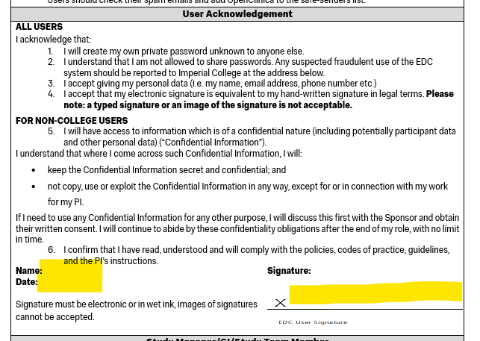
User Acceptance Forms (UAFs)
  Please only fill in the name, date and sign in the user acknowledgment box.
  Once filled in please return to the PANTHER team who will countersign and process with our Clinical Data Team.
  Please do not send it to them directly.
7

Slide 9

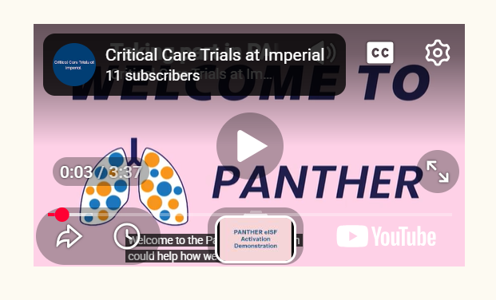
Consent Animation for Patients
We have a useful patient consent animation available online.
It summarises the study/processes in lay terminology so patients can understand the trial more easily.
Please signpost any patients/representatives who prefer visual aids or information.
www.panthertrial.org.uk/videos
8

Slide 10

New eISF Activation Video
A new eISF Activation Demonstration video is on the website for anyone needing a refresher or new staff joining
www.panthertrial.org.uk/videos
www.panthertrial.org.uk/videos
9

Slide 11

Translation assistance needed
Can you help?
We are also looking for members of staff who speak the following languages: Urdu, Arabic & Punjabi.
If you speak any of these languages, please do let us know.
Urdu
Arabic
Punjabi
10

Slide 12
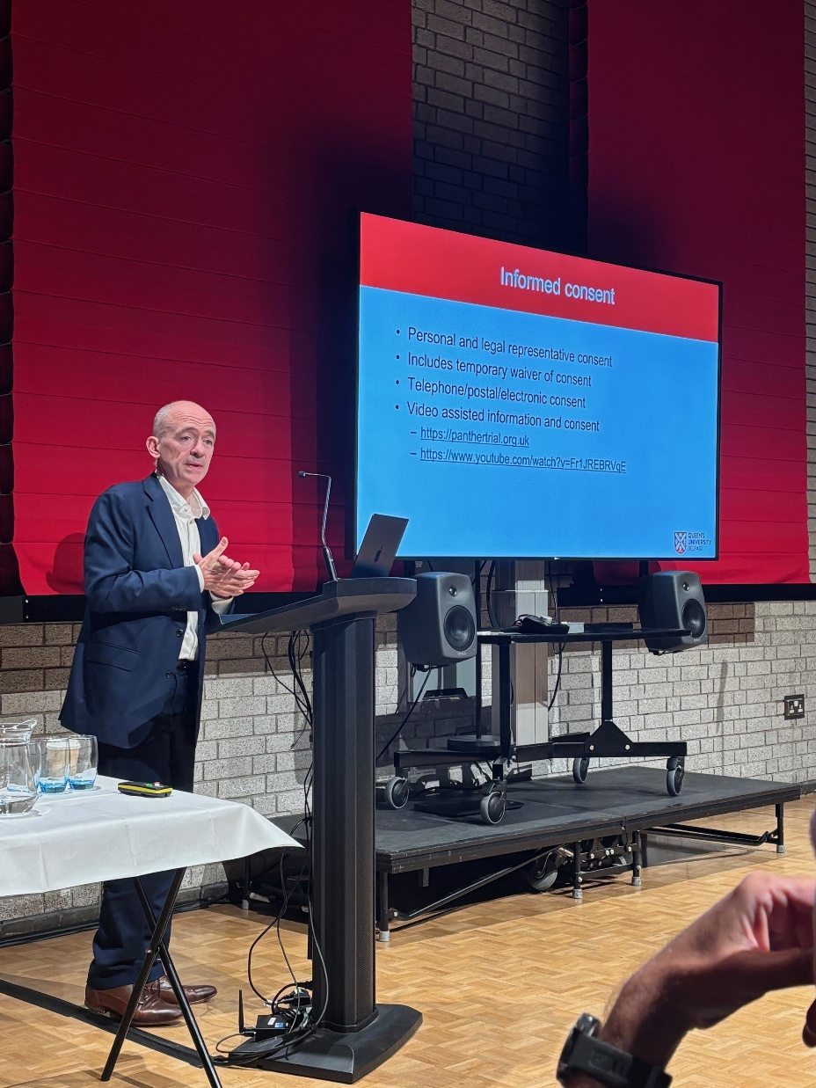

Upcoming Meetings
  PANTHER Research Meeting – UKCCRG 2026
  Venue – Chowen Lecture Theatre, Brighton & Sussex Medical School, University of Sussex, Falmer, Brighton, BN1 9PX
  Date – Monday 7th September
  Time – 17:30-18:00pm
  Refreshments will be provided
11

Slide 13
QUESTIONS?
12

Slide 14
THANK
YOU!
For your attention

