Slide 1
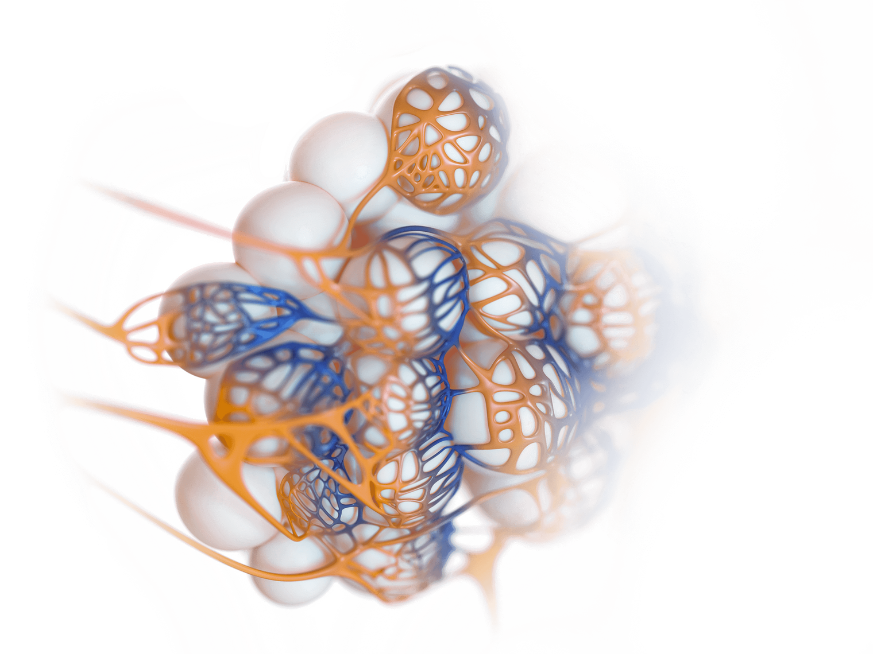


PANTHER
UK STUDY LAUNCH
PROF DANNY MCAULEY
Website
JULY 2025
www.panthertrial.org.uk

Slide 2

AGENDA
01
04
Our Team
Eligibility
02
05
Study Background
Subphenotypes
03
06
Trial Design
Interventions

Slide 3
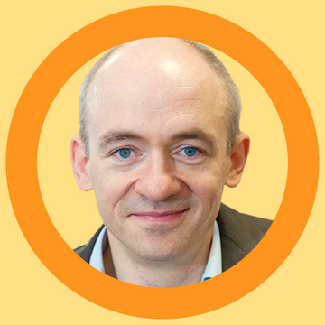



CI - Prof Danny McAuley
OUR TEAM
GET TO KNOW US
International Trial Manager - Janis Best-Lane
UK Trial Manager - Elizabeth Fagbodun
UK Trial Monitor - Michael Hetherington
Thank you for attending

Slide 4


INTERNATIONAL
Adaptive
PANTHER will be an adaptive platform trial, as such sample size projections evaluated by extensive simulation.
WE PLAN TO OPEN SITES GLOBALLY
Recruitment
We plan to have 70 sites worldwide with 30 sites in the UK. We are hoping to recruit 1 patient per ICU every month.
Study Duration
PANTHER is initially funded for 4 years, however
the study is designed to be potentially perpetual.
International clinical trials offer numerous benefits, including increased access to diverse patient populations, faster recruitment, and the potential for more rapid scientific advancement and broader application of treatments.

Slide 5
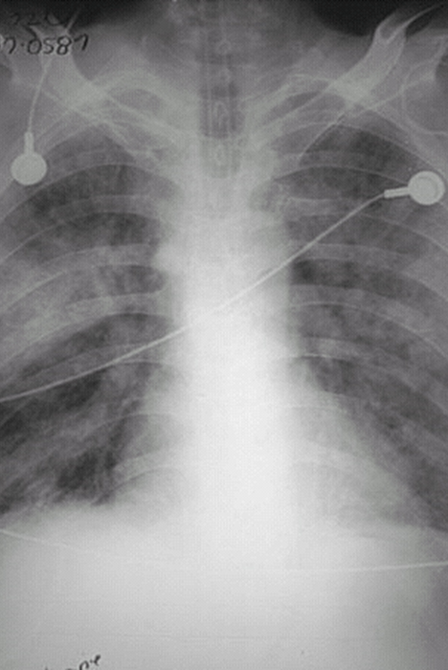
BACKGROUND
GET TO KNOW
ARDS is a heterogeneous clinical syndrome characterised by acute, inflammatory lung injury resulting in hypoxaemic respiratory failure. There are currently no pharmacological treatments for ARDS.

Slide 6
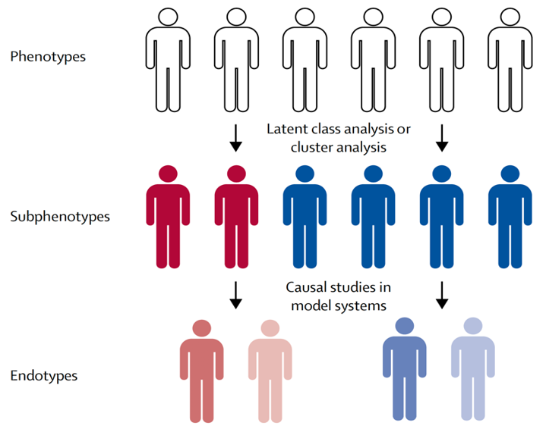
RATIONALE
PROBLEM
Patient heterogeneity in ARDS might drive the lack of pharmacological therapies.
SOLUTION
Reducing heterogeneity might increase the likelihood of finding effective pharmacological therapies.
ARDS subphenotypes demonstrate differential responses to specific interventions in secondary analyses of completed clinical trials.

Slide 7
PRIMARY ENDPOINT
28-day organ support-free days incorporating mortality
o Ordinal scale - composite of:
◦in-hospital death (-1)
◦number of days alive and not requiring organ support
◦Organ support – respiratory and cardiovascular

Slide 8
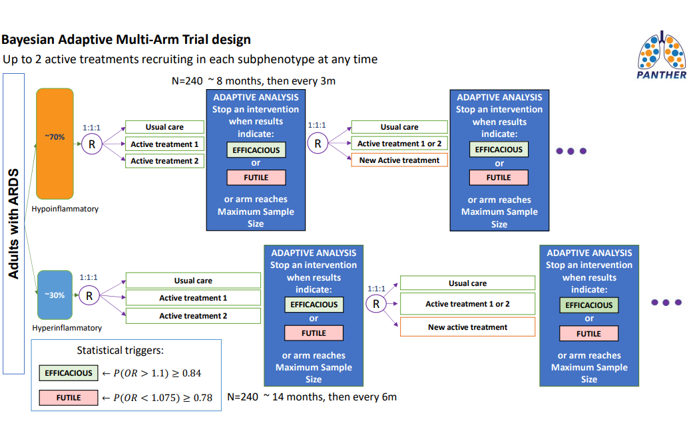
TRIAL DESIGN
BAYESIAN ADAPTIVE MULTI-ARM

Slide 9

MODULAR PROTOCOL
Master Protocol
Information that is generic to the trial irrespective of the regional location and interventions
TRIAL DESIGN
Intervention Specific Appendices
Information specific to each intervention
Subphenotype Appendix
Identification of subphenotypes and which devices will be used in the process
Region Specific Appendix
Information required to conduct the trial in a specific region
Statistical Design Appendix
Describes the design and simulation study to examine the trial operating characteristics

Slide 10

ELIGIBILITY
PLATFORM & INTERVENTIONS
01
Platform
There are 2 levels of eligibility. All patients must meet the eligibility criteria for the platform to be included in the study.
02
Interventions
The second level of eligibility is at the interventions. Patients who meet the eligibility will be randomised to one the available study interventions.

Slide 11

SUBPHENOTYPES
Hypoinflammatory
Hyperinflammatory
Lower: IL-6, IL-8, sTNFR1, PAI-1
Higher: Bicarbonate, Protein C, Systolic BP
Higher: IL-6, IL-8, sTNFR1, PAI-1
Lower: Bicarbonate, Protein C, Systolic BP

Slide 12


DEVICE
DETERMINING SUBPHENOTYPES
MultiSTAT device
Requirements
IL-6 and sTNFR1
Worst Bicarbonate level from a plasma or arterial blood gas
Subphenotype
Logistic regression equation

Slide 13


INTERVENTIONS
THE EVIDENCE
Simvastatin
Baricitinib
Simvastatin is a statin that has shown potential in modifying pathogenic mechanisms in ARDS. The recommended dose is 80 mg daily for up to 28 days or ICU discharge.
Baricitinib is an oral JAK1/2 inhibitor used for autoimmune diseases and has shown to reduce mortality in COVID-19 patients with ARDS. The recommended dose is 4mg daily for 10 days, with adjustments for renal dysfunction.

Slide 14


USUAL CARE
GUIDELINES
  Each subphenotype will have a control which will be usual care.
  Usual care will be directed by international treatment guidelines, such as the European Society of Intensive Care Medicine ARDS guidelines.
  Agreement to comply with these guidelines will be a condition for a site to participate in the trial to ensure standardised best practice usual care.

Slide 15


DATABASES
OpenClinica
Florence
Randomisation performed using a web-based system
called OpenClinica
The PANTHER study will utilise an eTMF and eISF provide by Florence

Slide 16
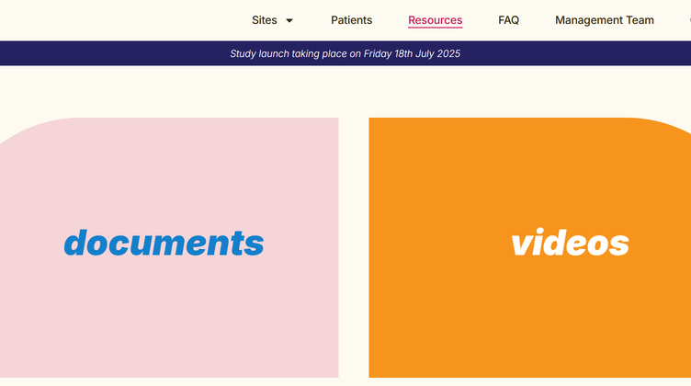
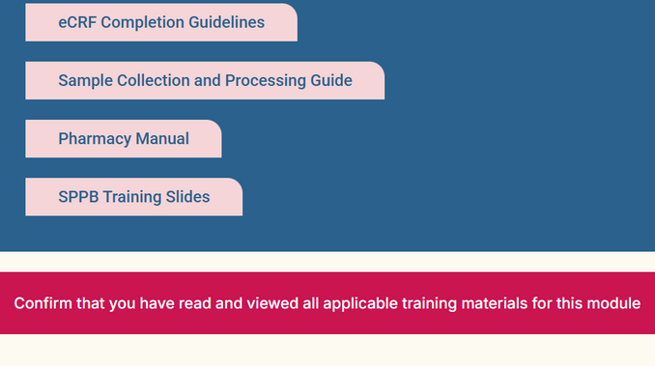
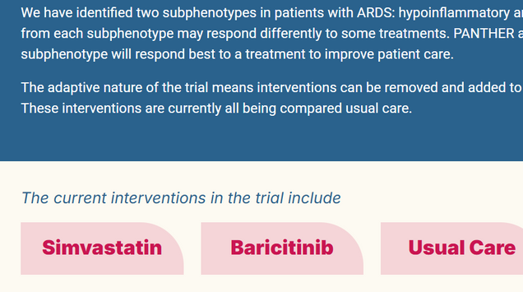

WEBSITE
WWW.PANTHERTRIAL.ORG.UK
Resources
Training
Current interventions
You will be able to download study documents from the website for easy access. It will also contain videos which you may find helpful when running the study.
Training materials can be found on the training tab under sites. You can complete training logs through the website or via the eTMF.
The most up to date interventions in the trial can also be found on the site page .

Slide 17


UPDATE
WHERE WE ARE NOW
Looking for sites to begin the site set up process
We hope to have our first site active by August 2025
REC & MHRA Approval received
Database go live in August
First patient recruited August

Slide 18

HOW TO JOIN
01
Feasibility
REQUIREMENTS
We will first need a feasibility form to be completed by the site. This will be followed up with an evaluation call and site selection letter.
02
SIV and Documents
Once your R&D has reviewed the LIP and the contract has been signed an SIV will be conducted. We will require the PI, pharmacist and lead nurse to attend at the minimum. Training logs, CV’s and GCP certificates will be required.
03
Greenlight
Once all required documents have been received your site will receive access to the database and greenlight.

Slide 19

EARLY CAREER RESEARCHERS
The PANTHER trial values the vital contributions of Early Career Researchers (ECRs) and is committed to recognizing their impact. Through mentorship, leadership opportunities, and career development support, we aim to empower ECRs to become the future leaders of the network. By actively participating in committees, research studies, and collaborative initiatives, ECRs play a key role in driving innovation within the trial.
Scan to join or
contact: m.r.smit@amsterdamumc.nl

Slide 20
THANK YOU
FOR JOINING, ANY QUESTIONS?
Telephone
Email
Website
Twitter
07714 051680
07526 568215
pantheruk@imperial.ac.uk
www.panthertrial.org.uk
@panther_trial
JULY 2025

